Slide 1
Studio Work & Inspiration
Anazoila Contreras

Slide 2
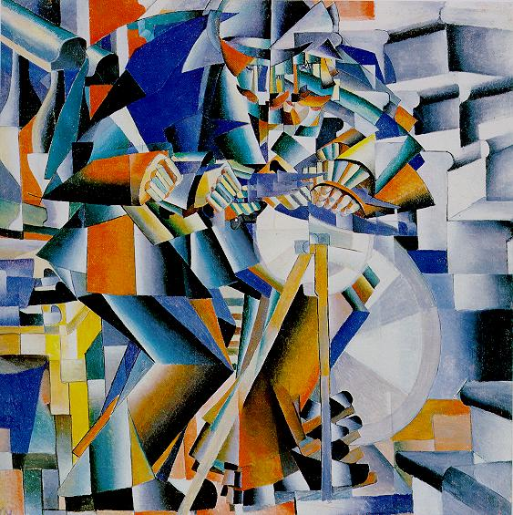
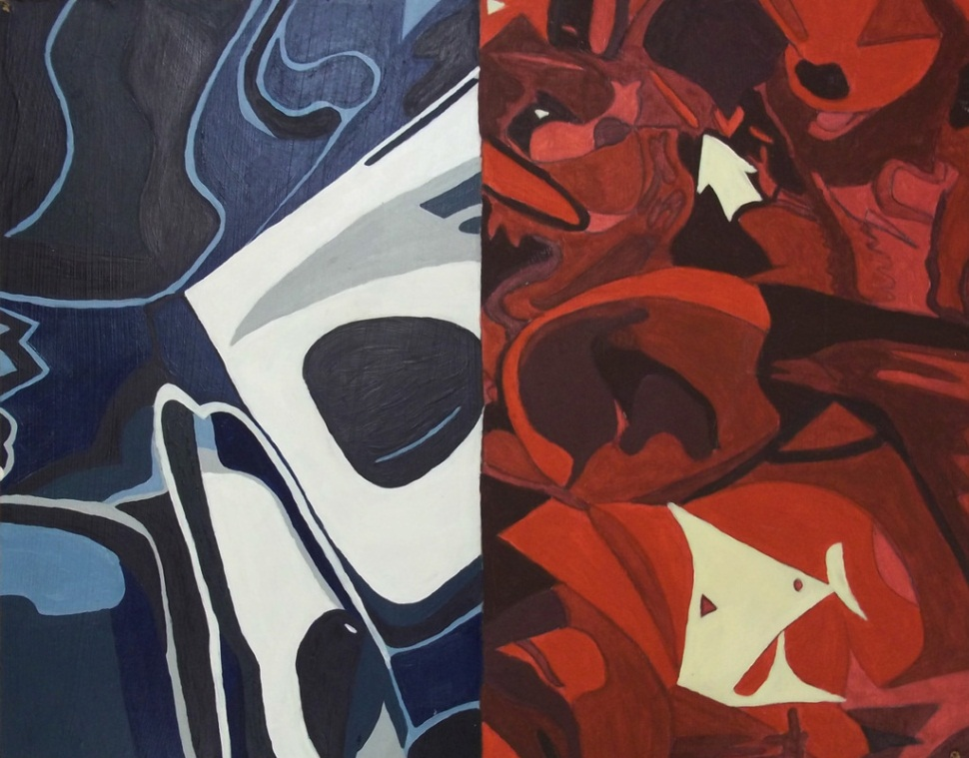
Crystal
Crystal
Acrylic on Canvas
September 2011
30.5 x45.7 cm
The Knife-Grinder
Malevich

Slide 3
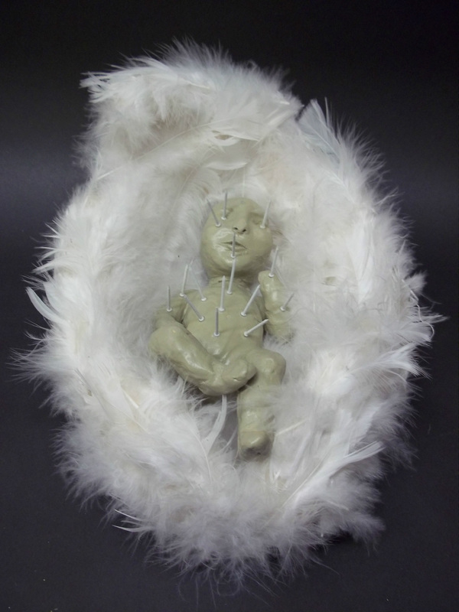
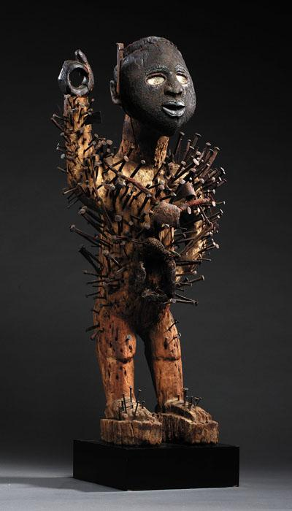
Sacred Vessel
Nail Fetish Figure of Hope
Clay, feathers & nails
September 2011
Unknown
By the Congo People

Slide 4
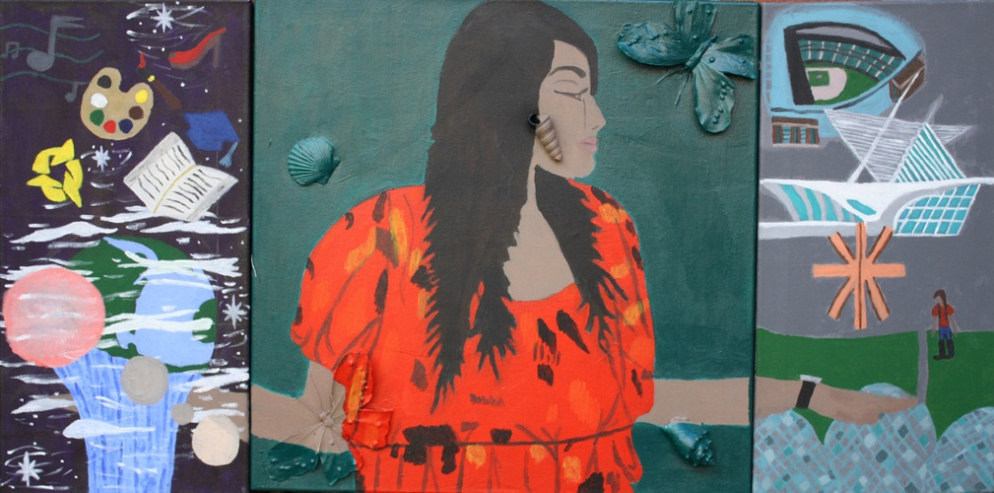
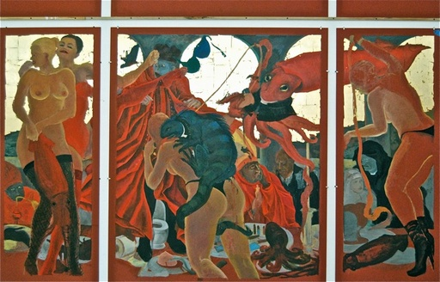
Artist in the City
The World in Your Hands
Acrylic on Canvas
October 2011
120x 70 cm
The Cloisters/Giant Squid Hunters
Masami Teraoika

Slide 5
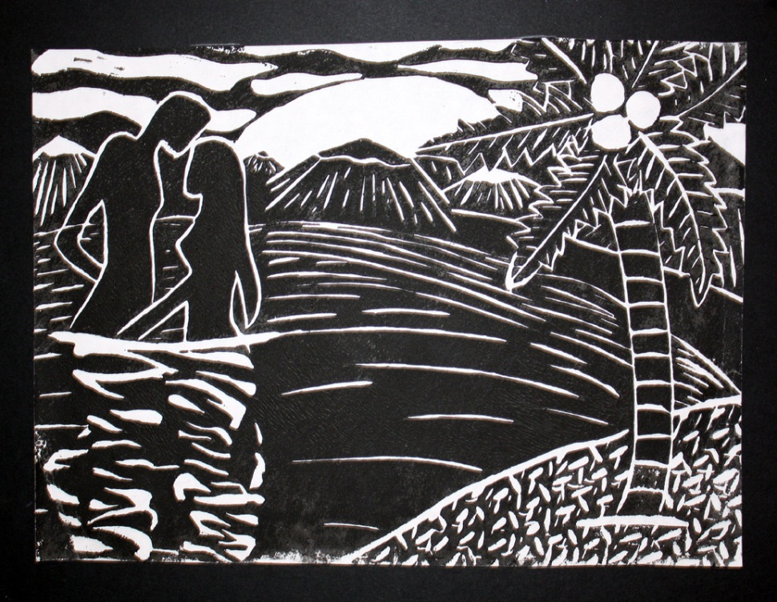
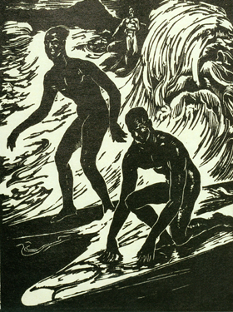
Block Print
Paradise of Passion
Ink on Paper
November 2011
22.9x 30.5 cm
Surfriders, Honolulu
Ambrose Patterson

Slide 6
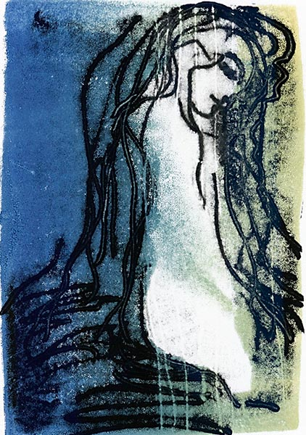
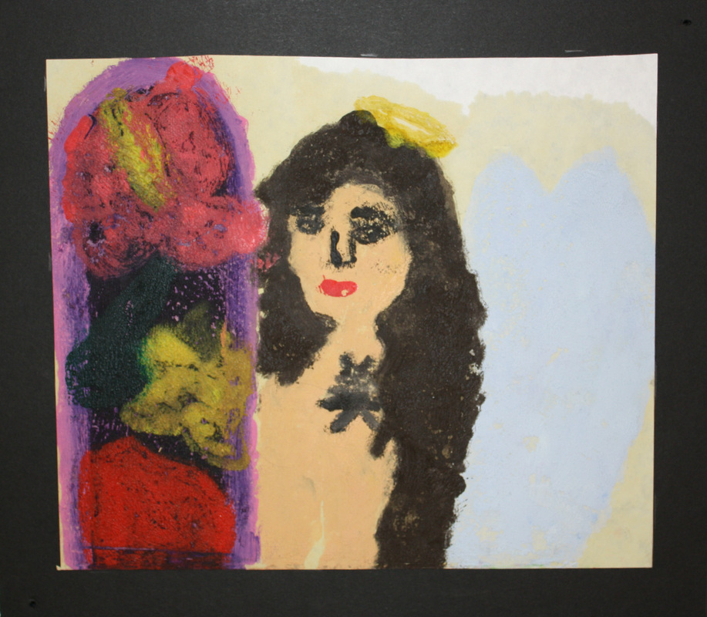
Mono Print
Surrounded by Beauty
Oil on Paper
December 2011
22.9x30.5 cm
Nereid
Unknown

Slide 7
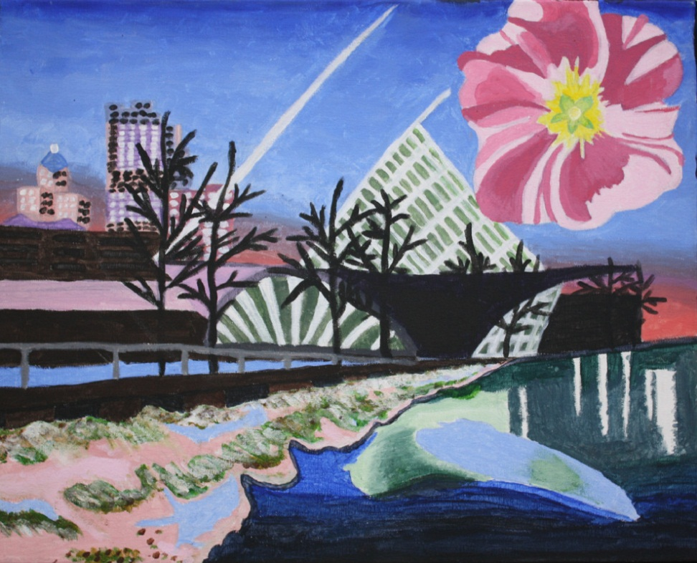
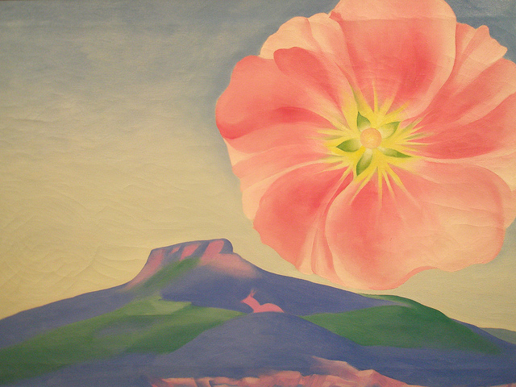
Choice Piece
Milwaukee Skyline
Acrylic on Canvas
January 2012
70x 30.5 cm
Hollyhock Pink with Pedernal
Georgia O'Keeffe

Slide 8
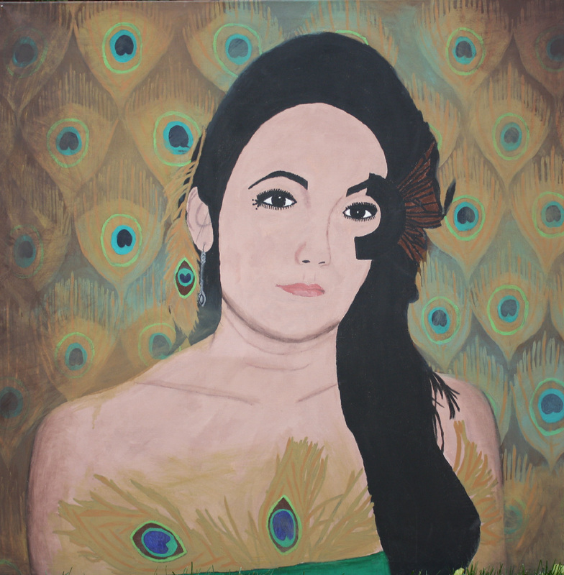
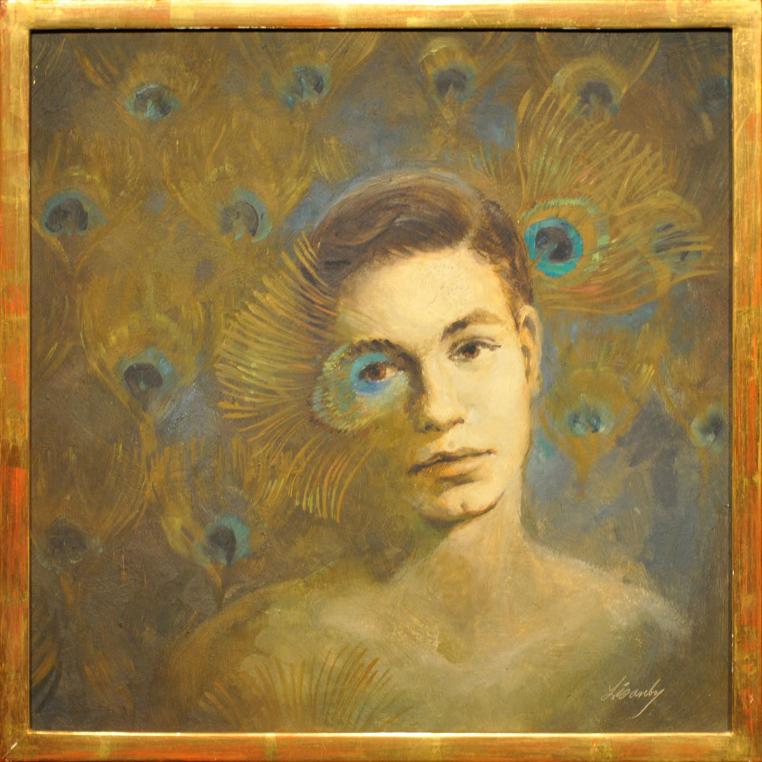
4x4 Self-Portrait
Self-Portrait Classic Peacock
Acrylic on Canvas
February 2012
121.9 x121.9 cm
Self-Portrait with Peacock Feather
Charles Lisanby

Slide 9
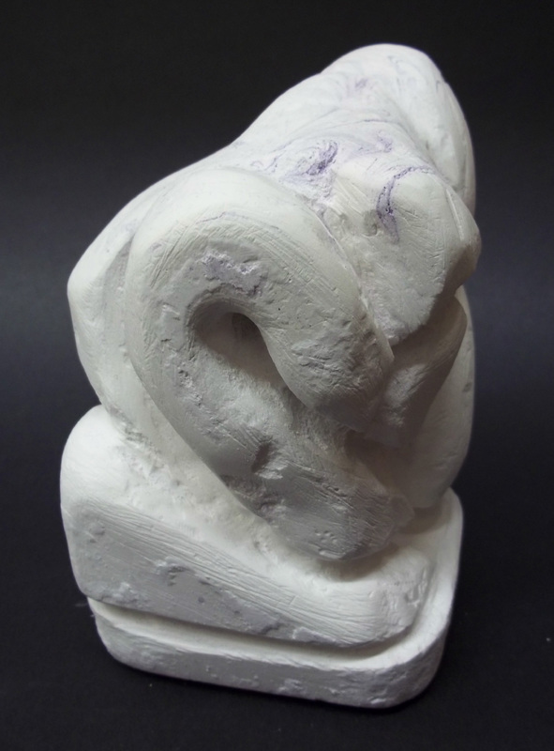
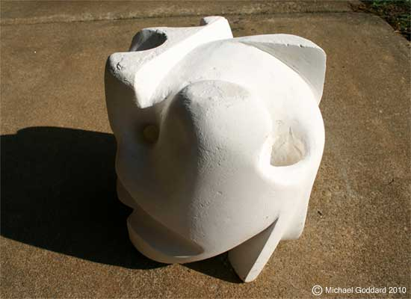
Abstract Form
Unknown
Curves of Life
Plaster
January 2012

Slide 10
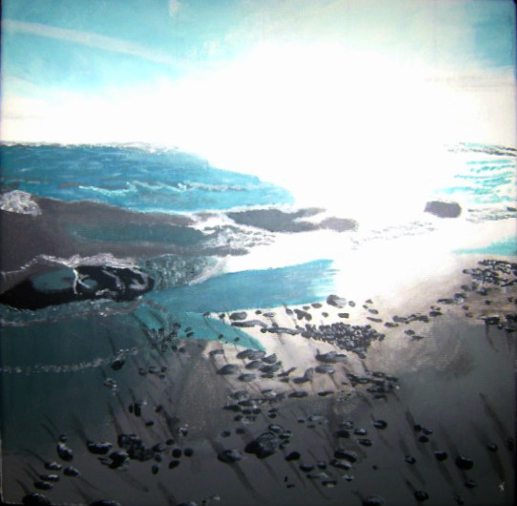
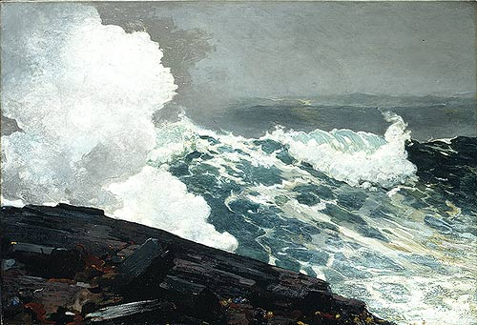
Photography Based
Picture Perfect Moment
Acrylic on Canvas
April 2012
30.5 x 30.5 cm
Winslow Homer

Slide 11
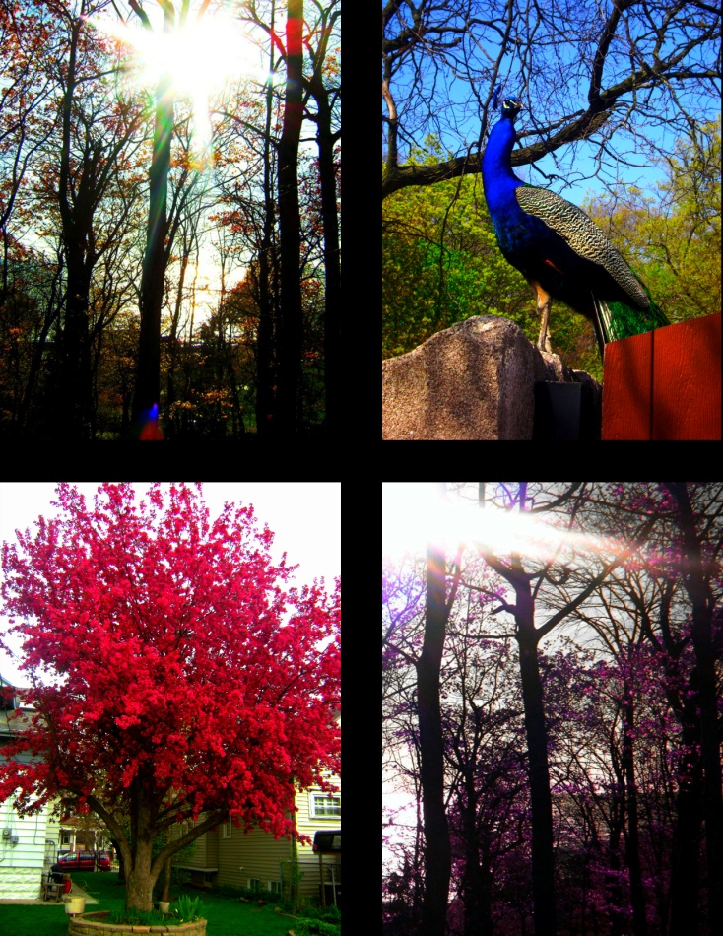
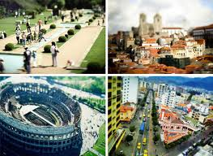
Holga
Phases of Life Throughout the Element
Ink on paper
December 2011
30.5x29.9 cm
Unknown

Slide 12
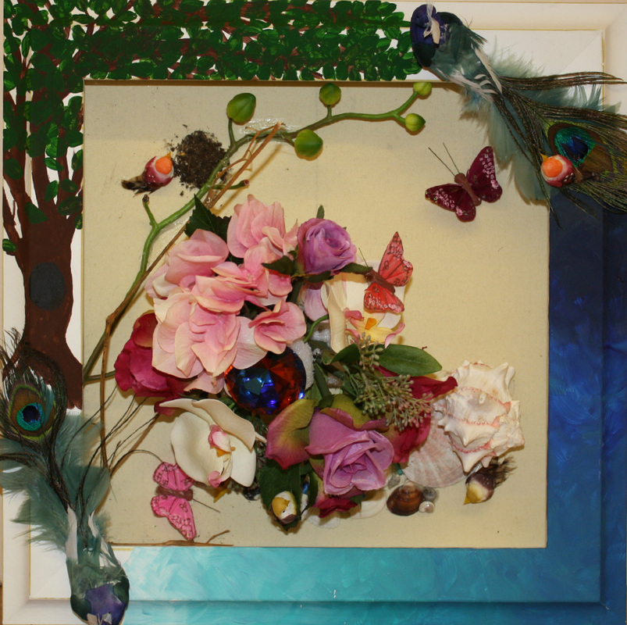
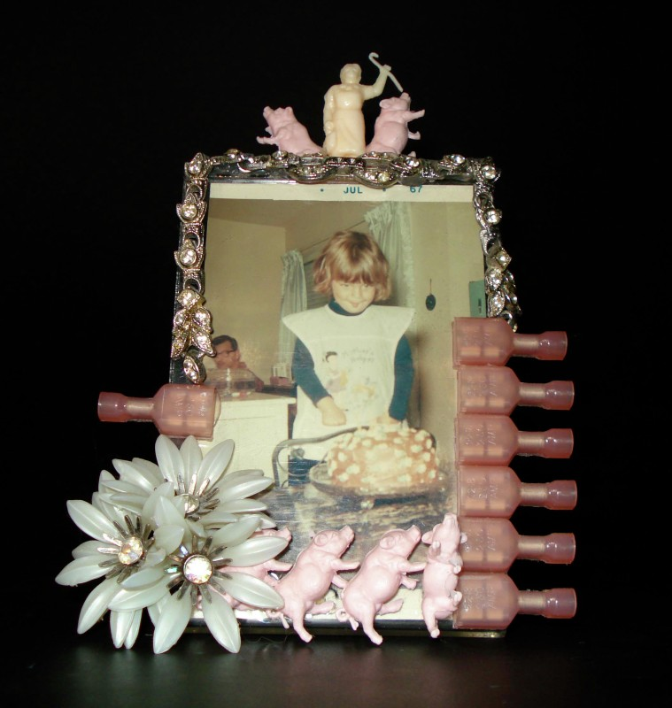
Found Object
Nature in all its Beauty
Found Objects
April 2012
30.5x 30.5 cm
Found Object Art
Jody Formica

Slide 13
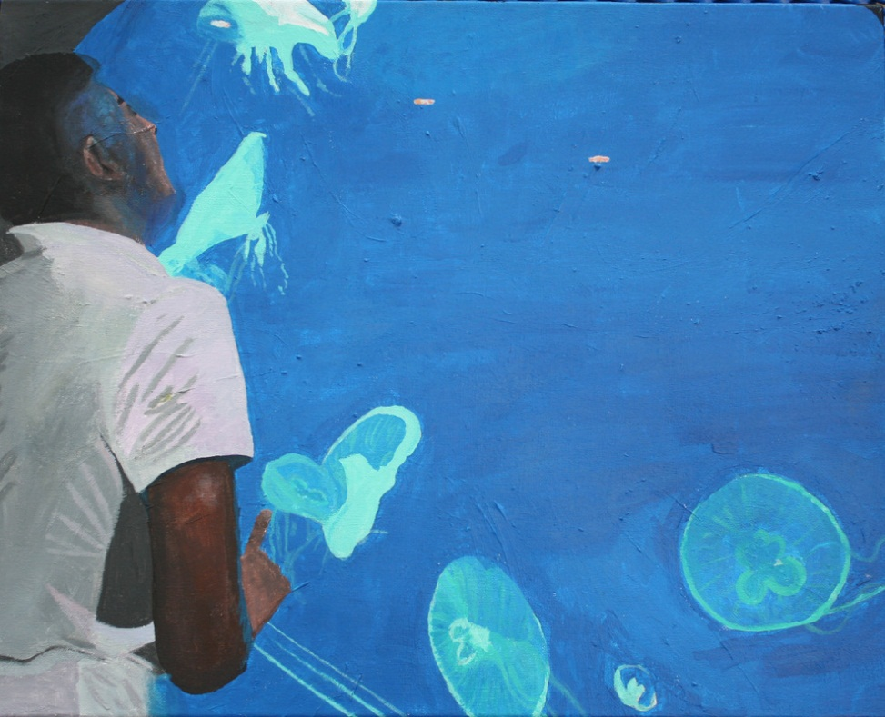
Discovery

Slide 14
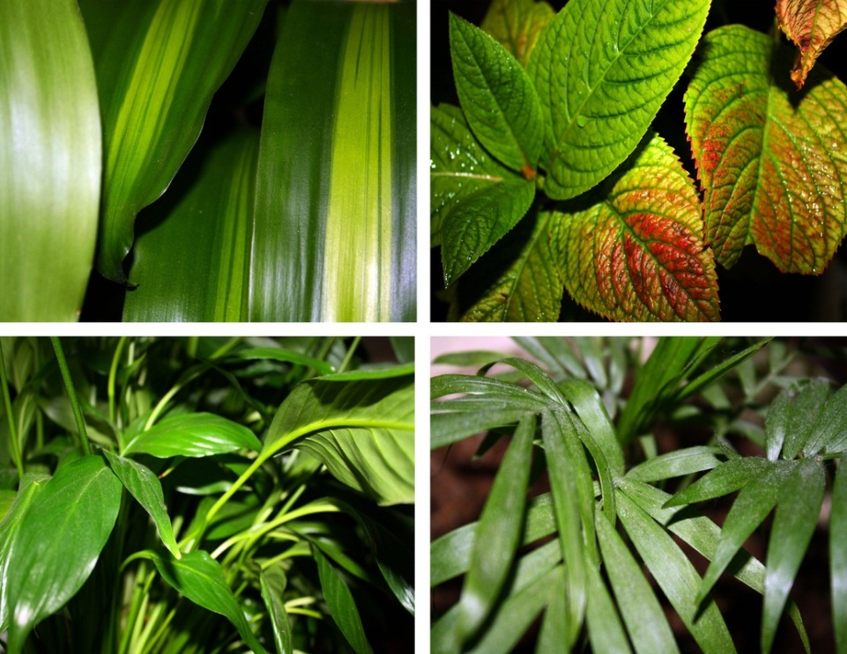
Photography
Nature
Ink on Paper
11x10.5 in

Slide 15
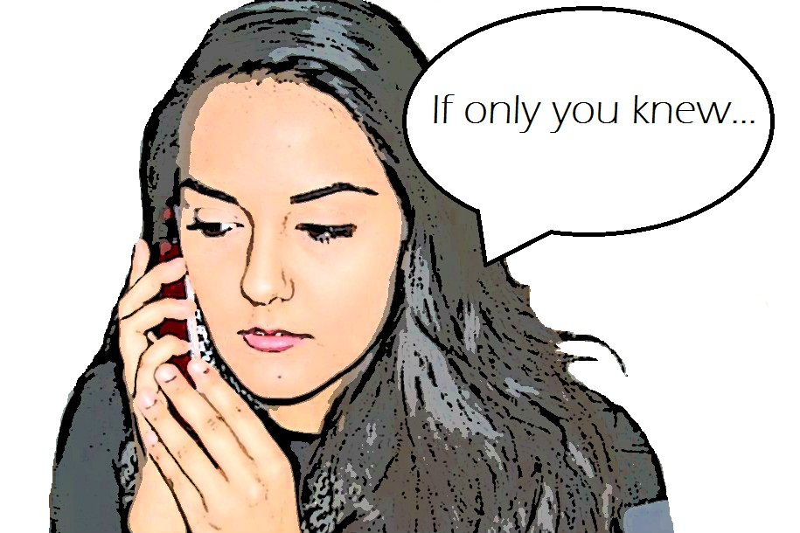
Digital Art (Lichtenstein)

Slide 16
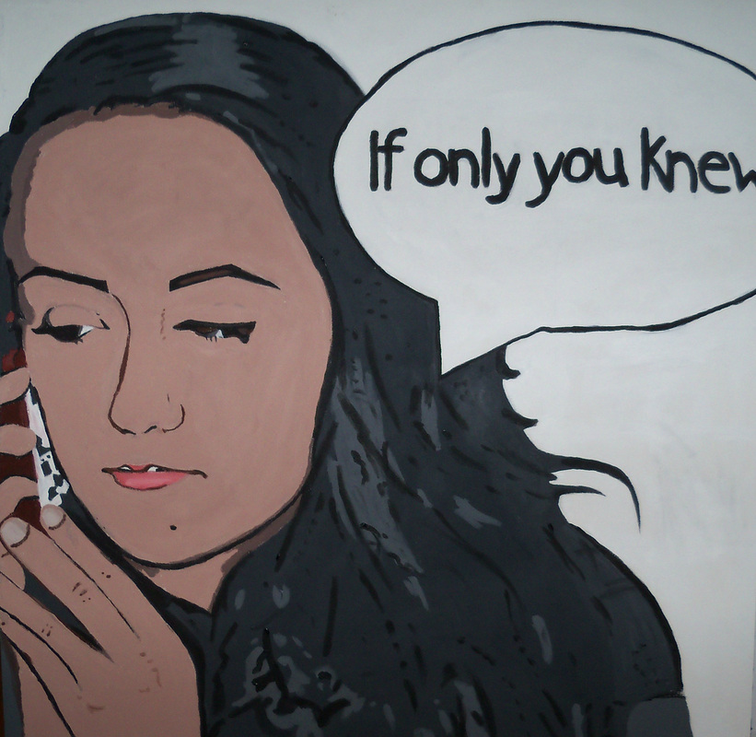
Lichtenstein Self-Portrait

